Slide 1
Introduction to Operating Systems and Processes
HPPS
David Marchant
Based on slides by:
Randal E. Bryant and David R. O’Hallaron with modifications by Troels Henriksen

Slide 2
A quick note about me
PhD student from Scotland
Jeg taler ikke dansk :(
‘David’ on the Discord
Office: HCØ, Building B, room 772-01-0-S06

Slide 3
Why study operating systems?
They are where the magic happens
For inspiration
  One of the most potent engineering abstractions in computing
  Each program thinks it has an entire machine to itself
  Controlled communication between programs.
  Abstracts over hardware differences
Practical skills
  Performance characteristics of the abstraction
  What is fundamentally possible?

Slide 4
Unix
What is Unix?
  Unix is an operating system developed in the 1970s by Ken Thompson and Dennis Ritchie
  Most modern operating systems heavily influenced by Unix (even Windows)
  Many operating systems are direct descendants: Linux, iOS, macOS, the *BSDs, etc
Why Unix?
  Unix is simple and representative of modern systems
  We will use Unix designs for all examples

Slide 5
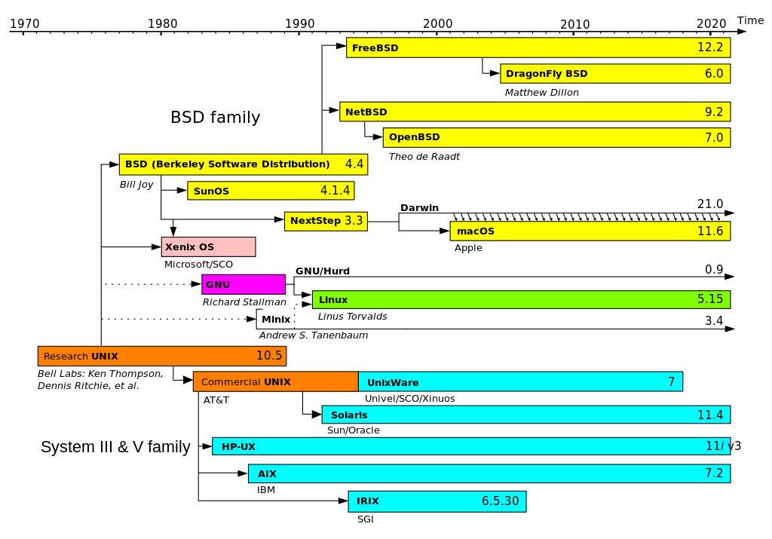

Slide 6
Processes
Definition: A process is an instance of a running program.
  One of the most profound ideas in computer science
  Not the same as “program” or “processor”
Process provides each program with two key abstractions:
  Logical control flow
    Each program seems to have exclusive use of the CPU
    Provided by kernel mechanism called context switching
  Private address space
    Each program seems to have exclusive use of main memory.
    Provided by kernel mechanism called virtual memory
Memory
Stack
Heap
Data
Code
CPU
Registers

Slide 7
Multiprocessing: The Illusion
Memory
Memory
Memory
Stack
Stack
Stack
Heap
Heap
…
Heap
Data
Data
Data
Code
Code
Code
CPU
CPU
CPU
Registers
Registers
Registers
Computer runs many processes simultaneously
  Applications for one or more users
    Web browsers, email clients, editors, …
  Background tasks
    Monitoring network & I/O devices

Slide 8

Multiprocessing Example
Running program “top” on Mac
  System has 123 processes, 5 of which are active
  Identified by Process ID (PID)

Slide 9
Multiprocessing: The (Traditional) Reality
Memory
Stack
Stack
Stack
Heap
Heap
…
Heap
Data
Data
Data
Code
Code
Code
Saved registers
Saved registers
Saved registers
CPU
Registers
Single processor executes multiple processes concurrently
  Process executions interleaved (multitasking)
  Address spaces managed by virtual memory system (later in course)
  Register values for non-executing (suspended) processes saved in memory

Slide 10
Multiprocessing: The (Traditional) Reality
Memory
Stack
Stack
Stack
Heap
Heap
…
Heap
Data
Data
Data
Code
Code
Code
Saved registers
Saved registers
Saved registers
CPU
Registers
Save current registers in memory

Slide 11
Multiprocessing: The (Traditional) Reality
Memory
Stack
Stack
Stack
Heap
Heap
…
Heap
Data
Data
Data
Code
Code
Code
Saved registers
Saved registers
Saved registers
CPU
Registers
Schedule next process for execution

Slide 12
Multiprocessing: The (Traditional) Reality
Memory
Stack
Stack
Stack
Heap
Heap
…
Heap
Data
Data
Data
Code
Code
Code
Saved registers
Saved registers
Saved registers
CPU
Registers
Load saved registers and switch address space (context switch)

Slide 13
Multiprocessing: The (Modern) Reality
Memory
Stack
Stack
Stack
Heap
Heap
…
Heap
Data
Data
Data
Code
Code
Code
Saved registers
Saved registers
Saved registers
CPU
CPU
Multicore processors
  Multiple CPUs on single chip
  Share main memory (and some of the caches)
  Each can execute a separate process
    Scheduling of processors onto cores done by kernel
Registers
Registers

Slide 14
Concurrent Processes
Each process is a logical control flow.
Two processes run concurrently (are concurrent) if their flows overlap in time
Otherwise, they are sequential
Examples (running on single core):
  Concurrent: A & B, A & C
  Sequential: B & C
Process A
Process B
Process C
Time

Slide 15
User View of Concurrent Processes
Control flows for concurrent processes are physically disjoint in time
However, we can think of concurrent processes as running in parallel with each other
Process A
Process B
Process C
Time

Slide 16
Context Switching
Processes are managed by a shared chunk of memory-resident OS code called the kernel
  Important: the kernel is not a separate process, but rather runs as part of some existing process.
Control flow passes from one process to another via a context switch
Process A
Process B
user code
kernel code
context switch
Time
user code
kernel code
context switch
user code

Slide 17
Overheads
Context switch is not free
  It is a fairly quick operation to switch from one process to another (roughly 1.2 microseconds plus cache misses)
  But many processes switching can pile on the overheads
Most schedulers have some variant of round-robin scheduling
  This is where the scheduler will try to ensure each process will get some execution time reasonably regularly
  Avoids livelock (where things can progress, but don’t)
Excessive numbers of processes cause threshing
We will be returning to concurrency in the new year

Slide 18
System Calls
Systems calls ask the operating system to perform a task on behalf of the process.
Each x86-64 system call has a unique ID number
Examples:
Number | Name | Description
0 | read | Read file
1 | write | Write file
2 | open | Open file
3 | close | Close file
4 | stat | Get info about file
57 | fork | Create process
59 | execve | Execute a program
60 | _exit | Terminate process
62 | kill | Send signal to process

Slide 19
System Call Example: Opening File
User calls: open(filename, options)
Calls __open function, which invokes system call instruction syscall
00000000000e5d70 <__open>:
...
e5d79: b8 02 00 00 00 mov $0x2,%eax # open is syscall #2
e5d7e: 0f 05 syscall # Return value in %rax
e5d80: 48 3d 01 f0 ff ff cmp $0xfffffffffffff001,%rax
...
e5dfa: c3 retq
%rax contains syscall number
Other arguments in %rdi, %rsi, %rdx, %r10, %r8, %r9
Return value in %rax
Negative value is an error corresponding to negative errno
User code
Kernel code
syscall
Exception
cmp
Open file
Returns

Slide 20
Summary
Processes
  At any given time, system has multiple active processes
  Only one can execute at a time on a single core, though
  Each process appears to have total control of
  processor + private memory space

Slide 21
A System Using Physical Addressing
Main memory
0:
1:
Physical address
(PA)
2:
CPU
3:
4
4:
5:
6:
7:
8:
...
M-1:
Data word
Used in “simple” systems like embedded microcontrollers in devices like cars, elevators, and digital picture frames

Slide 22
A System Using Virtual Addressing
Main memory
0:
CPU Chip
1:
Virtual address
(VA)
Physical address
(PA)
2:
CPU
MMU
3:
4
4:
4100
5:
6:
7:
8:
...
M-1:
Data word
Used in all modern servers, laptops, and smart phones
One of the great ideas in computer science

Slide 23
Address Spaces
Linear address space: Ordered set of contiguous non-negative integer addresses:
{0, 1, 2, 3 … }
Virtual address space: Set of N = 2^{n} virtual addresses
{0, 1, 2, 3, …, N-1}
Physical address space: Set of M = 2^{m} physical addresses
{0, 1, 2, 3, …, M-1}

Slide 24
Why Virtual Memory (VM)?
Uses main memory efficiently
  Use DRAM as a cache for parts of a virtual address space
Simplifies memory management
  Each process gets the same uniform linear address space
Isolates address spaces
  One process can’t interfere with another’s memory
  User program cannot access privileged kernel information and code

Slide 25
VM as a Tool for Caching
Conceptually, virtual memory is an array of N contiguous bytes stored on disk (from a caching perspective!)
The contents of the array on disk are cached in physical memory (DRAM cache)
  These cache blocks are called pages (size is P = 2^{p} bytes)
Virtual memory
Physical memory
VP 0
Unallocated
0
VP 1
Cached
0
Empty
PP 0
Uncached
PP 1
Unallocated
Empty
Cached
Uncached
Empty
Cached
PP 2^{m-p}-1
VP 2^{n-p}-1
Uncached
M-1
N-1
Virtual pages (VPs)
stored on disk
Physical pages (PPs)
cached in DRAM

Slide 26
DRAM Cache Organization
DRAM cache organization driven by the enormous miss penalty
  DRAM is about 10x slower than SRAM (CPU cache)
  Disk is about 10,000x slower than DRAM
Consequences
  Large page (block) size: typically 4 KB, sometimes 4 MB
  Fully associative
    Any VP can be placed in any PP
    Requires a “large” mapping function – different from cache memories
  Highly sophisticated, expensive replacement algorithms
    Too complicated and open-ended to be implemented in hardware
  Write-back rather than write-through

Slide 27
Enabling Data Structure: Page Table
A page table is an array of page table entries (PTEs) that maps virtual pages to physical pages.
  Per-process kernel data structure in DRAM
Physical memory
(DRAM)
Physical page
number or
disk address
Valid
VP 1
PP 0
PTE 0
0
null
VP 2
1
VP 7
VP 4
PP 3
1
0
1
0
null
Virtual memory
(disk)
0
PTE 7
1
VP 1
Memory resident
page table
(DRAM)
VP 2
VP 3
VP 4
VP 6
VP 7

Slide 28
Page Hit
Page hit: reference to VM word that is in physical memory (DRAM cache hit)
Physical memory
(DRAM)
Physical page
number or
disk address
Virtual address
Valid
VP 1
PP 0
PTE 0
0
null
VP 2
1
VP 7
VP 4
PP 3
1
0
1
0
null
Virtual memory
(disk)
0
PTE 7
1
VP 1
Memory resident
page table
(DRAM)
VP 2
VP 3
VP 4
VP 6
VP 7

Slide 29
Page Fault
Page fault: reference to VM word that is not in physical memory (DRAM cache miss)
Physical memory
(DRAM)
Physical page
number or
disk address
Virtual address
Valid
VP 1
PP 0
PTE 0
0
null
VP 2
1
VP 7
VP 4
PP 3
1
0
1
0
null
Virtual memory
(disk)
0
PTE 7
1
VP 1
Memory resident
page table
(DRAM)
VP 2
VP 3
VP 4
VP 6
VP 7

Slide 30
Handling Page Fault
Page miss causes page fault (an exception)
Physical memory
(DRAM)
Physical page
number or
disk address
Virtual address
Valid
VP 1
PP 0
PTE 0
0
null
VP 2
1
VP 7
VP 4
PP 3
1
0
1
0
null
Virtual memory
(disk)
0
PTE 7
1
VP 1
Memory resident
page table
(DRAM)
VP 2
VP 3
VP 4
VP 6
VP 7

Slide 31
Handling Page Fault
Page miss causes page fault (an exception)
Page fault handler selects a victim to be evicted (here VP 4)
Physical memory
(DRAM)
Physical page
number or
disk address
Virtual address
Valid
VP 1
PP 0
PTE 0
0
null
VP 2
1
VP 7
VP 4
PP 3
1
0
1
0
null
Virtual memory
(disk)
0
PTE 7
1
VP 1
Memory resident
page table
(DRAM)
VP 2
VP 3
VP 4
VP 6
VP 7

Slide 32
Handling Page Fault
Page miss causes page fault (an exception)
Page fault handler selects a victim to be evicted (here VP 4)
Physical memory
(DRAM)
Physical page
number or
disk address
Virtual address
Valid
VP 1
PP 0
PTE 0
0
null
VP 2
1
VP 7
VP 3
PP 3
1
1
0
0
null
Virtual memory
(disk)
0
PTE 7
1
VP 1
Memory resident
page table
(DRAM)
VP 2
VP 3
VP 4
VP 6
VP 7

Slide 33
Handling Page Fault
Page miss causes page fault (an exception)
Page fault handler selects a victim to be evicted (here VP 4)
Offending instruction is restarted: page hit!
Physical memory
(DRAM)
Physical page
number or
disk address
Virtual address
Valid
VP 1
PP 0
PTE 0
0
null
VP 2
1
VP 7
VP 3
PP 3
1
1
0
0
null
Virtual memory
(disk)
0
PTE 7
1
VP 1
Memory resident
page table
(DRAM)
VP 2
VP 3
Key point: Waiting until the miss to copy the page to DRAM is known as demand paging
VP 4
VP 6
VP 7

Slide 34
Allocating Pages
Allocating a new page (VP 5) of virtual memory.
Physical memory
(DRAM)
Physical page
number or
disk address
Valid
VP 1
PP 0
PTE 0
0
null
VP 2
1
VP 7
VP 3
PP 3
1
1
0
0
Virtual memory
(disk)
0
PTE 7
1
VP 1
Memory resident
page table
(DRAM)
VP 2
VP 3
VP 4
VP 5
VP 6
VP 7

Slide 35
Locality to the Rescue Again!
Virtual memory seems terribly inefficient, but it works because of locality.
At any point in time, programs tend to access a set of active virtual pages called the working set
  Programs with better temporal locality will have smaller working sets
If (working set size < main memory size)
  Good performance for one process after compulsory misses
If ( SUM(working set sizes) > main memory size )
  Thrashing: Performance meltdown where pages are swapped (copied) in and out continuously

Slide 36
VM as a Tool for Memory Management
Key idea: each process has its own virtual address space
  It can view memory as a simple linear array
  Mapping function scatters addresses through physical memory
    Well-chosen mappings can improve locality
0
Address
translation
0
Virtual Address Space for Process 1:
Physical
Address
Space (DRAM)
VP 1
VP 2
PP 2
...
N-1
PP 6
(e.g., read-only
library code)
Virtual Address Space for Process 2:
0
PP 8
VP 1
VP 2
...
...
N-1
M-1

Slide 37
VM as a Tool for Memory Management
Simplifying memory allocation
  Each virtual page can be mapped to any physical page
  A virtual page can be stored in different physical pages at different times
Sharing code and data among processes
  Map virtual pages to the same physical page (here: PP 6)
0
Address
translation
0
Virtual Address Space for Process 1:
Physical
Address
Space (DRAM)
VP 1
VP 2
PP 2
...
N-1
PP 6
(e.g., read-only
library code)
Virtual Address Space for Process 2:
0
PP 8
VP 1
VP 2
...
...
N-1
M-1

Slide 38
VM as a Tool for Memory Protection
Extend PTEs with permission bits
MMU checks these bits on each access
Physical
Address Space
Process i:
SUP
READ
WRITE
EXEC
Address
VP 0:
No
Yes
No
No
PP 6
VP 1:
No
Yes
Yes
Yes
PP 4
VP 2:
Yes
Yes
Yes
No
PP 2
PP 2
•
•
•
PP 4
PP 6
Process j:
SUP
READ
WRITE
EXEC
Address
PP 8
VP 0:
No
Yes
No
Yes
PP 9
PP 9
VP 1:
No
Yes
Yes
No
PP 6
VP 2:
No
Yes
Yes
Yes
PP 11
PP 11

Slide 39
VM Address Translation
Virtual Address Space
  V = {0, 1, …, N–1}
Physical Address Space
  P = {0, 1, …, M–1}
Address Translation
MAP: V ➡ P U {¬}
  For virtual address a:
    MAP(a) = a’ if data at virtual address a is at physical address a’ in P
    MAP(a) = ¬ if data at virtual address a is not in physical memory
      Either invalid or stored on disk

Slide 40
Summary of Address Translation Symbols
Basic Parameters
  N = 2^{n} : Number of addresses in virtual address space
  M = 2^{m} : Number of addresses in physical address space
  P = 2^{p} : Page size (bytes)
Components of the virtual address (VA)
  TLBI: TLB index
  TLBT: TLB tag
  VPO: Virtual page offset
  VPN: Virtual page number
Components of the physical address (PA)
  PPO: Physical page offset (same as VPO)
  PPN: Physical page number

Slide 41
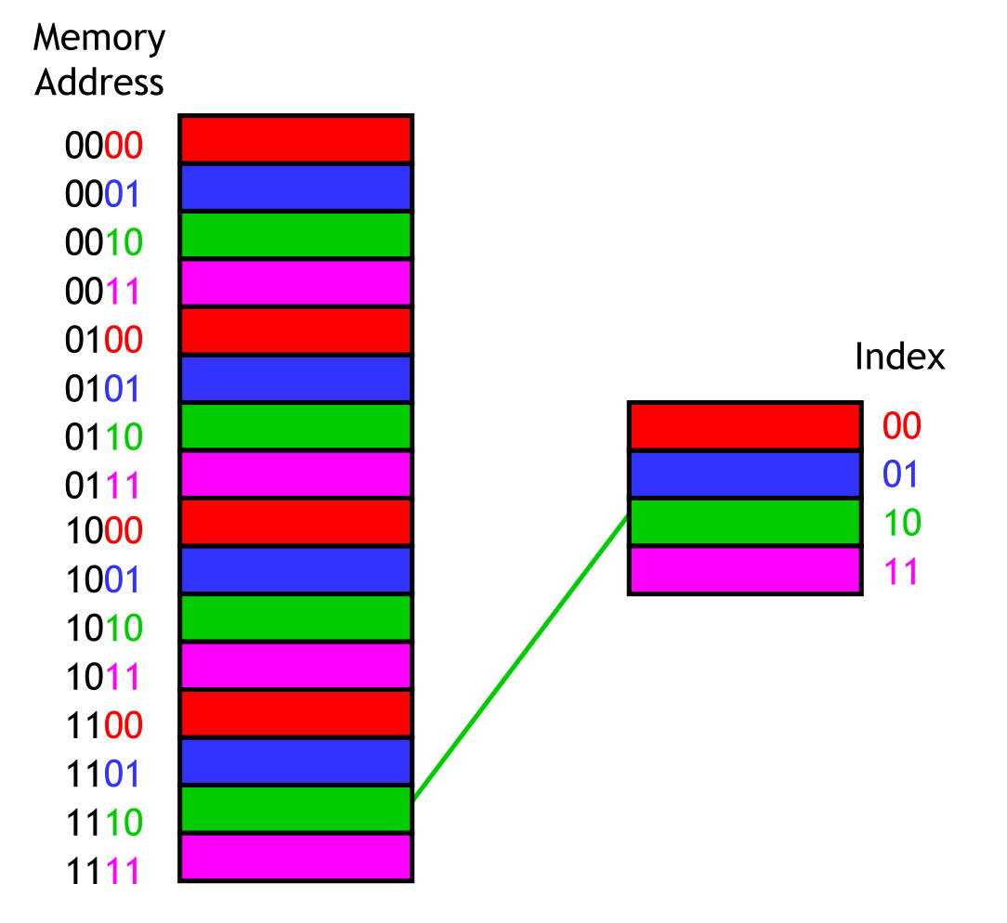
Memory Mapping
Direct Memory Mapping
  Each memory address maps to one cache block.
  Least significant bits of the address gives us the tag in the cache.
  Gives rise to conflict misses if we keep using say memory address 0000, 1000, 0000, 1000.
  But its quick and easy to implement (the quick is often the enemy of the good).

Slide 42
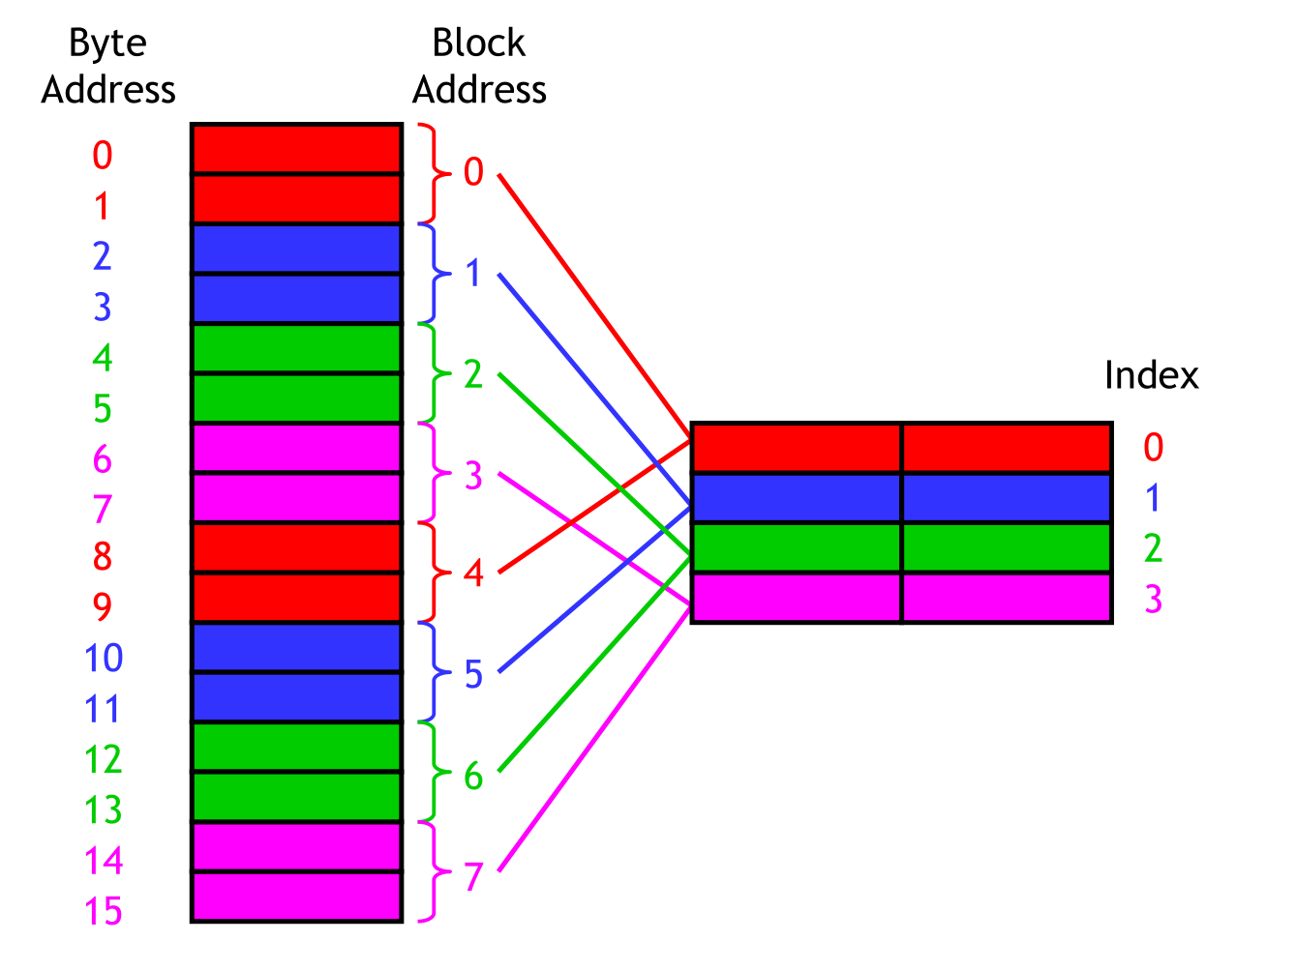
Memory Mapping
Set Associate Mapping
  We always store more than a single byte at a time in practice.
  Typically 4-32 KiBs, though this can differ by hardware.
  If we only stored single bytes, then spatial locality would mean nothing...
  Most examples present as though only a single byte for space/simplicity.
  Note the distinction between the memory address and the block address.

Slide 43
Address Translation With a Page Table
Virtual address
Page table
base register
(PTBR)
n-1
p
p-1
0
Virtual page number (VPN)
Virtual page offset (VPO)
Page table
Valid
Physical page number (PPN)
Physical page table
address for the current
process
Valid bit = 0:
Page not in memory
(page fault)
Valid bit = 1
m-1
p
p-1
0
Physical page number (PPN)
Physical page offset (PPO)
Physical address

Slide 44
Address Translation: Page Hit
CPU Chip
2
Cache/
Memory
MMU
PTEA
1
PTE
CPU
VA
3
PA
4
Data
5
1) Processor sends virtual address to MMU
2-3) MMU fetches PTE from page table in memory
4) MMU sends physical address to cache/memory
5) Cache/memory sends data word to processor

Slide 45
Address Translation: Page Fault
Exception
Page fault handler
4
CPU Chip
2
Cache/
Memory
Disk
MMU
PTEA
Victim page
1
5
CPU
VA
PTE
7
3
New page
6
1) Processor sends virtual address to MMU
2-3) MMU fetches PTE from page table in memory
4) Valid bit is zero, so MMU triggers page fault exception
5) Handler identifies victim (and, if dirty, pages it out to disk)
6) Handler pages in new page and updates PTE in memory
7) Handler returns to original process, restarting faulting instruction

Slide 46
Integrating VM and Cache
PTE
CPU Chip
PTE
MMU
PTEA
hit
Memory
PTEA
PTEA
miss
PTEA
CPU
VA
PA
PA
PA
miss
PA
hit
Data
L1
cache
Data
VA: virtual address
PA: physical address
PTE: page table entry
PTEA = PTE address

Slide 47
Speeding up Translation with a TLB
Page table entries (PTEs) are cached in L1 like any other memory word
  PTEs may be evicted by other data references
  PTE hit still requires a small L1 delay
Solution: Translation Lookaside Buffer (TLB)
  Small set-associative hardware cache in MMU
  Maps virtual page numbers to physical page numbers
  Contains complete page table entries for small number of pages

Slide 48
Accessing the TLB
MMU uses the VPN portion of the virtual address to access the TLB:
T = 2^{t} sets
VPN
TLBT matches tag of line within set
n-1
p+t
p+t-1
p
p-1
0
TLB tag (TLBT)
TLB index (TLBI)
VPO
Set 0
v
tag
PTE
v
tag
PTE
TLBI selects
the set
Set 1
v
tag
PTE
v
tag
PTE
…
Set T-1
v
tag
PTE
v
tag
PTE

Slide 49
TLB Hit
CPU Chip
TLB
2
PTE
VPN
3
Cache/
Memory
1
MMU
CPU
VA
PA
4
Data
5
A TLB hit eliminates a memory access

Slide 50
TLB Miss
CPU Chip
TLB
4
2
PTE
VPN
Cache/
Memory
1
MMU
3
CPU
VA
PTEA
PA
5
Data
6
A TLB miss incurs an additional memory access (the PTE)
Fortunately, TLB misses are rare. Why?

Slide 51
Multi-Level Page Tables
Suppose:
  4KB (2¹²) page size, 48-bit address space, 8-byte PTE
Problem:
  Would need a 512 GB page table!
    2⁴⁸ * 2⁻¹² * 2³ = 2³⁹ bytes
Common solution: Multi-level page table
Example: 2-level page table
  Level 1 table: each PTE points to a page table (always memory resident)
  Level 2 table: each PTE points to a page
  (paged in and out like any other data)
Level 2
Tables
Level 1
Table
...
...

Slide 52
A Two-Level Page Table Hierarchy
Level 1
page table
Level 2
page tables
Virtual
memory
0
VP 0
PTE 0
...
PTE 0
...
VP 1023
2K allocated VM pages
for code and data
PTE 1
PTE 1023
VP 1024
PTE 2 (null)
...
PTE 3 (null)
VP 2047
PTE 4 (null)
PTE 0
Gap
PTE 5 (null)
...
PTE 6 (null)
PTE 1023
PTE 7 (null)
6K unallocated VM pages
PTE 8
1023 null
PTEs
(1K - 9)
null PTEs
PTE 1023
1023
unallocated
pages
1023 unallocated pages
VP 9215
1 allocated VM page
for the stack
32 bit addresses, 4KB pages, 4-byte PTEs
...

Slide 53
Translating with a k-level Page Table
Page table
base register
(PTBR)
n-1
VIRTUAL ADDRESS
p-1
0
VPN 1
VPN 2
...
VPN k
VPO
Level 1
page table
Level 2
page table
Level k
page table
...
...
PPN
m-1
p-1
0
PPN
PPO
PHYSICAL ADDRESS

Slide 54
Summary
Programmer’s view of virtual memory
  Each process has its own private linear address space
  Cannot be corrupted by other processes
System view of virtual memory
  Uses memory efficiently by caching virtual memory pages
    Efficient only because of locality
  Simplifies memory management and programming
  Simplifies protection by providing a convenient interpositioning point to check permissions

